Slide 1
ICS Project
A GUI For Chatting System
By Alex Ni Jiasheng
Jiang Daokang

Slide 2
Motivatioin
01
Simulation of real-world chatting system

Slide 3
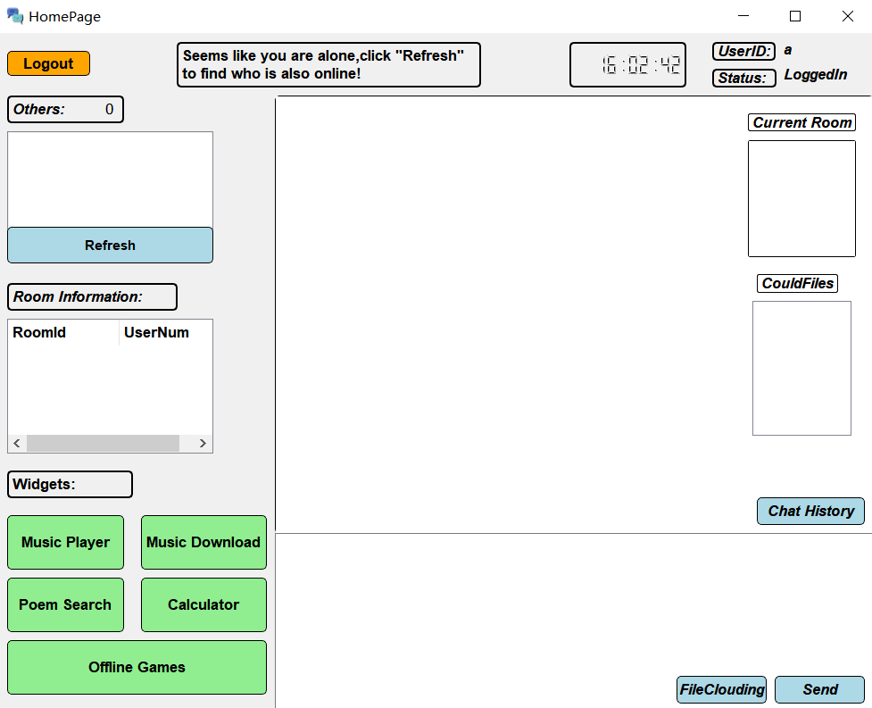
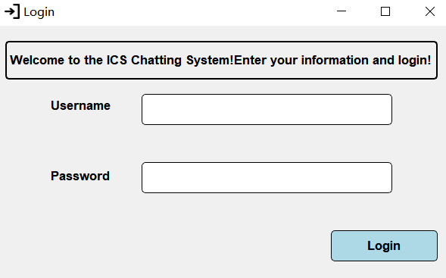
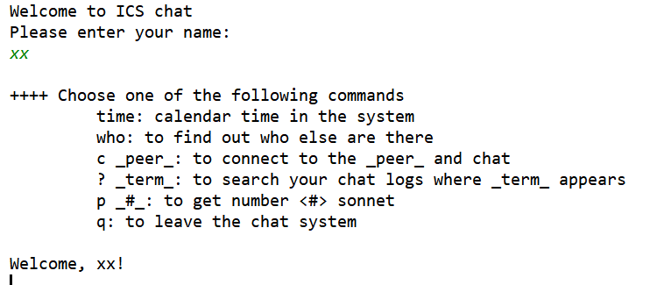

Slide 4
OverView
02
Interface

Slide 5
Home Page(Not Chatting)

Slide 6
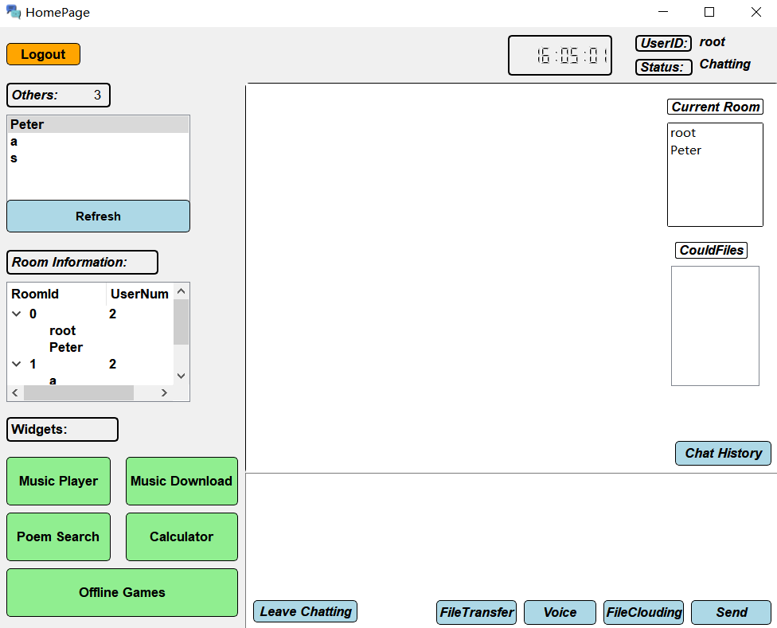
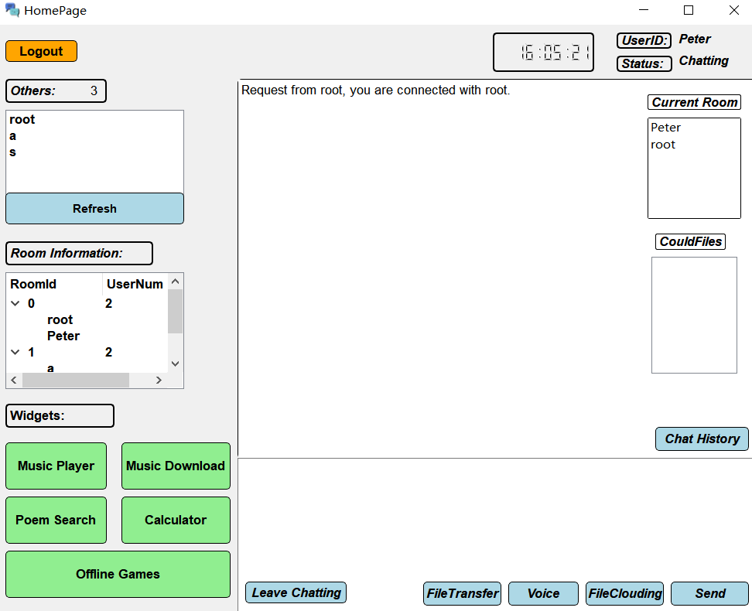
Home Page(Chatting)

Slide 7
Functionality
Chatting Utilities
Login and Register
Invitation
Asynchronous Voice Chatting
File Clouding
File transferring
Local Utilities
Local Music Player
Music Crawling
Calculator
Poem Search
Chat History
Offline Games

Slide 8
03 Live Demos
Funtionality

Slide 9
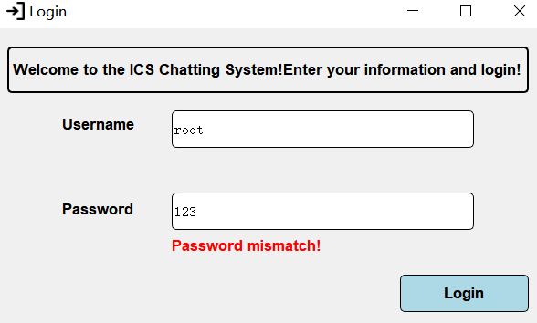
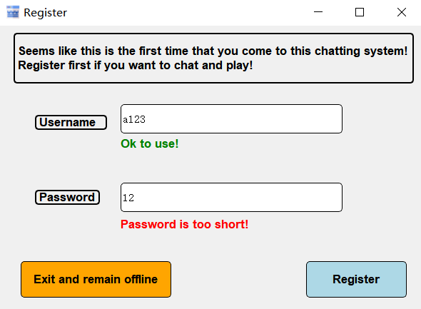
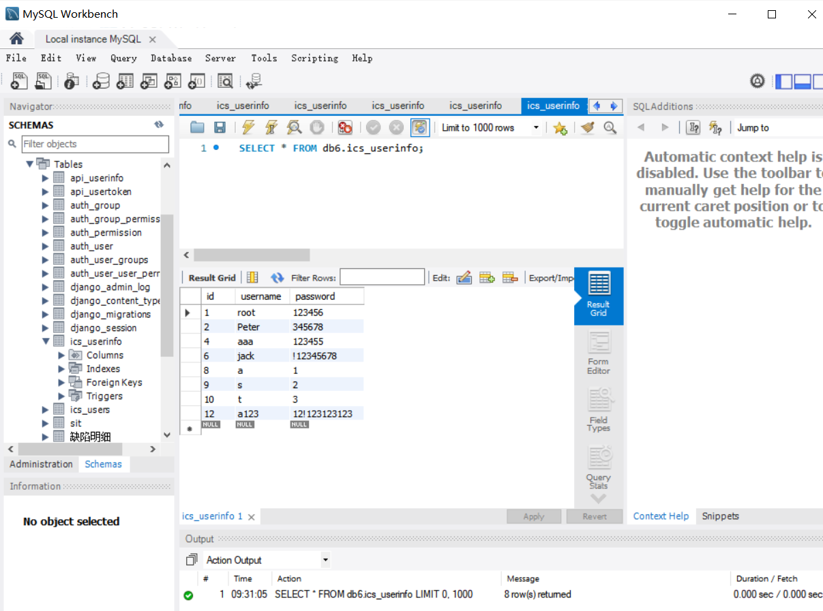
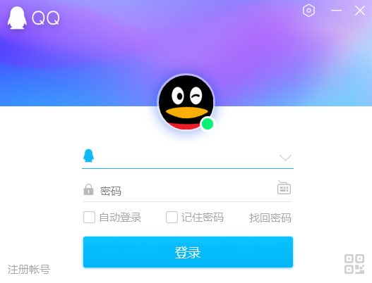
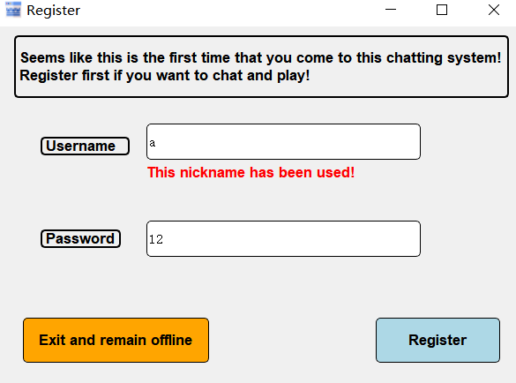
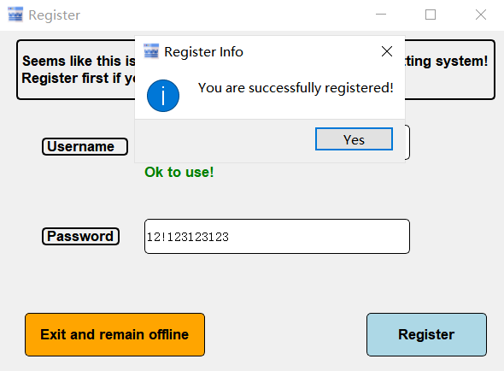
Login and Register

Slide 10
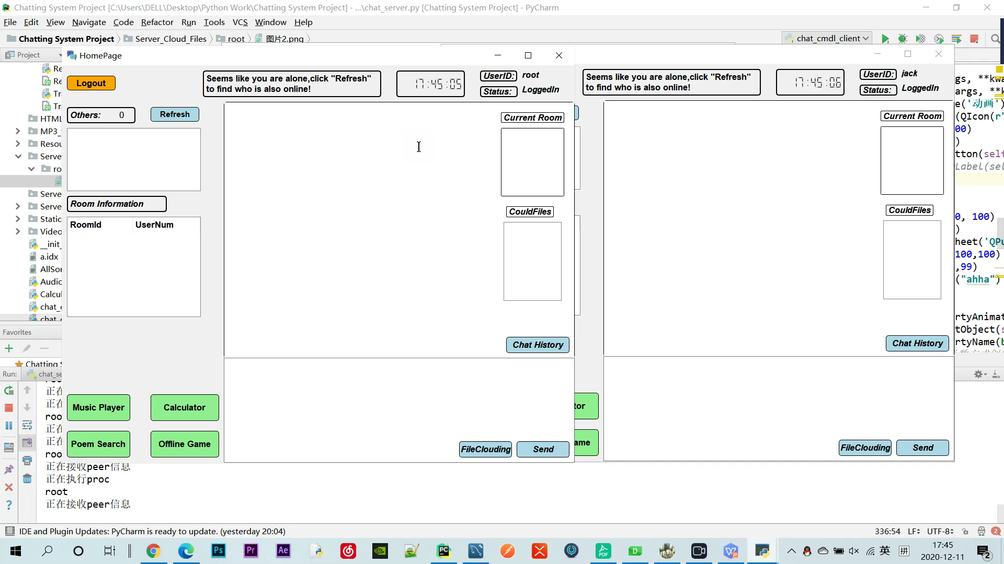
Invitation

Slide 11
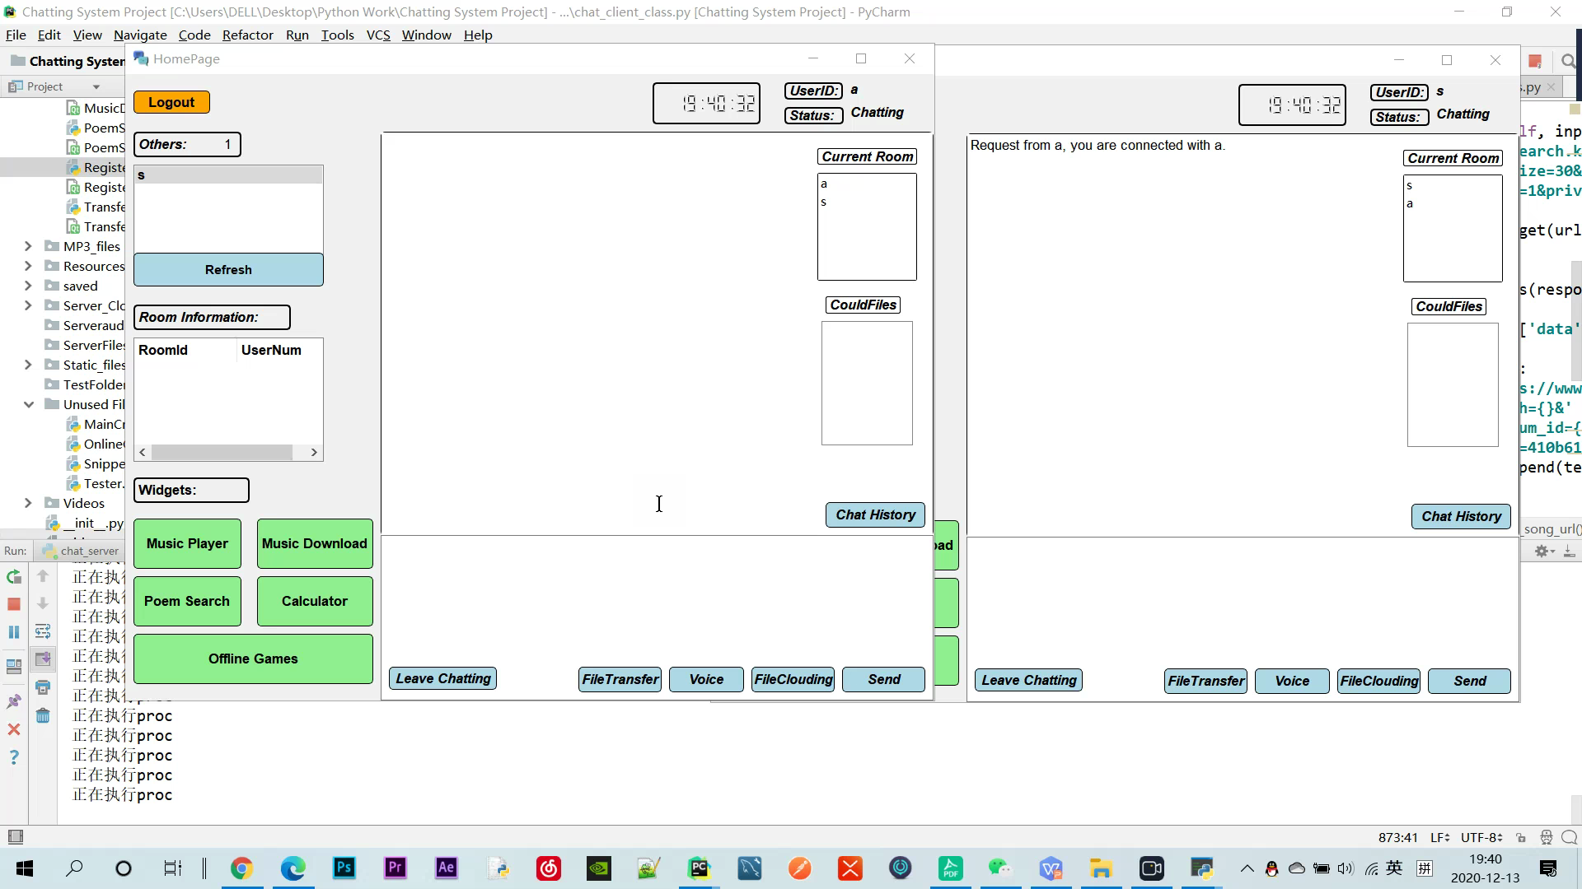
File Transferring

Slide 12
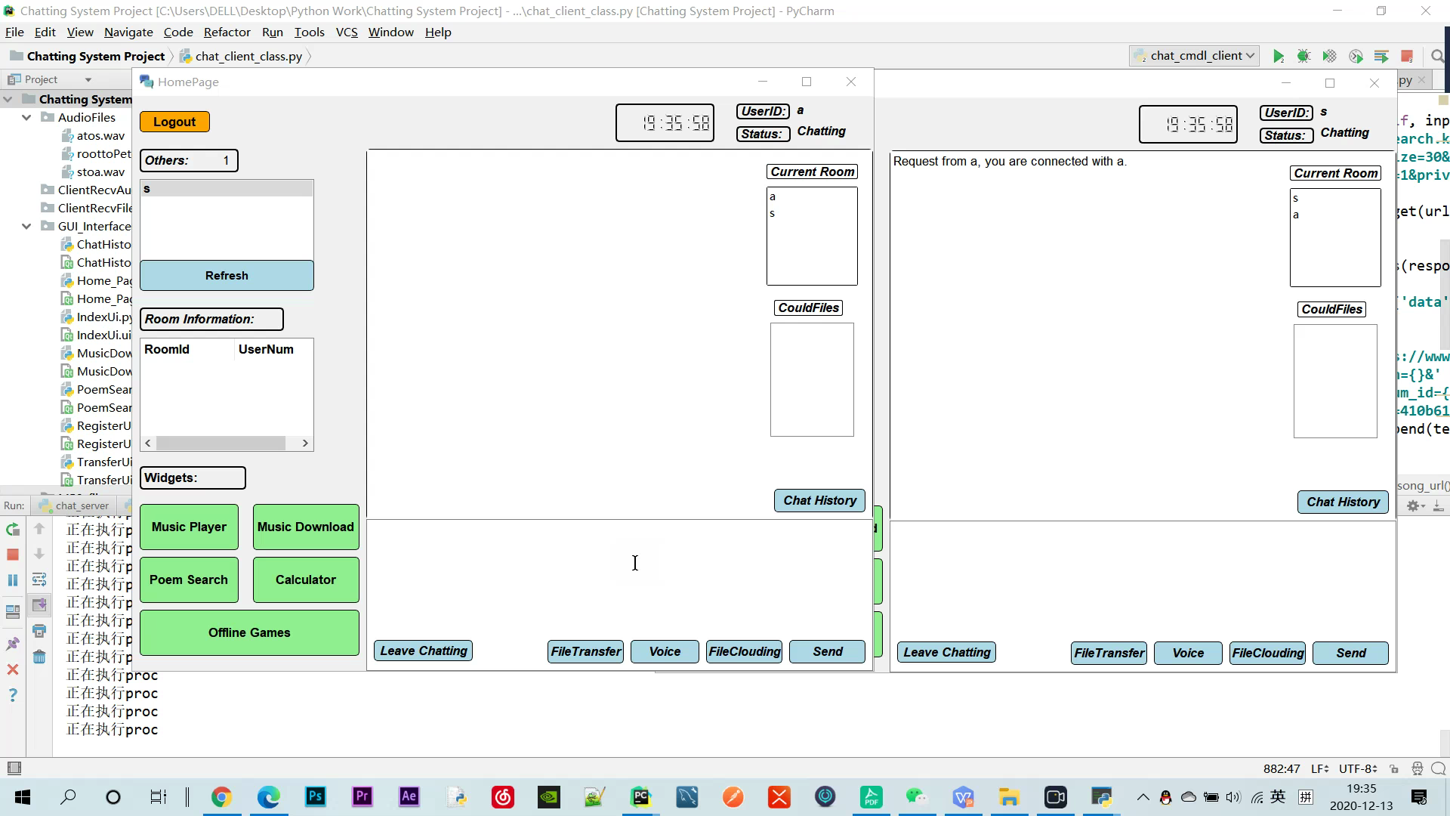

Asychronous Voice Chatting

Slide 13
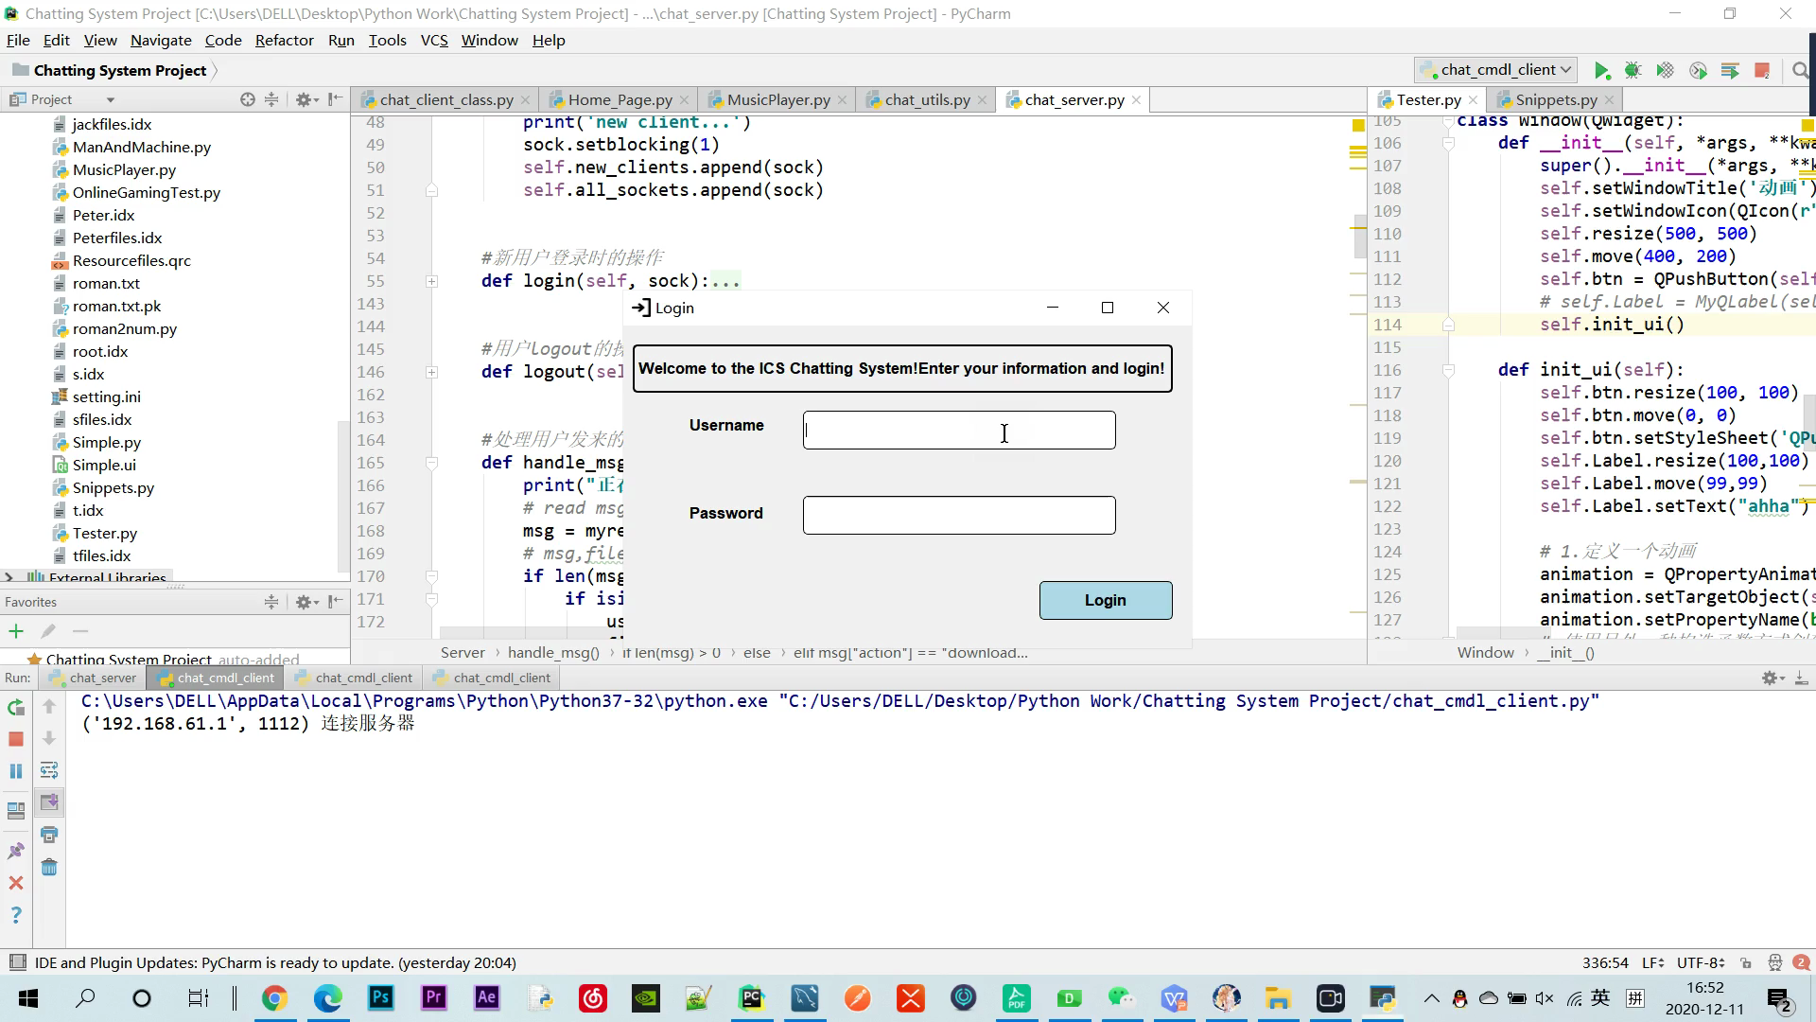
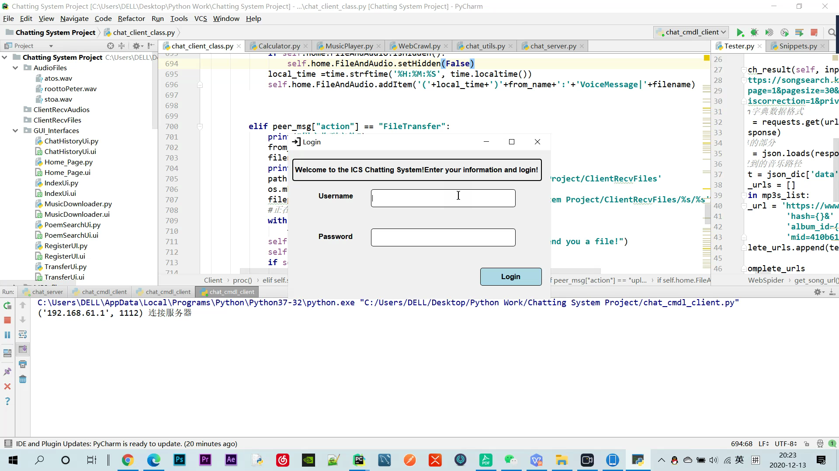
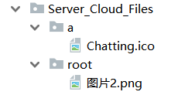
FileClouding

Slide 14
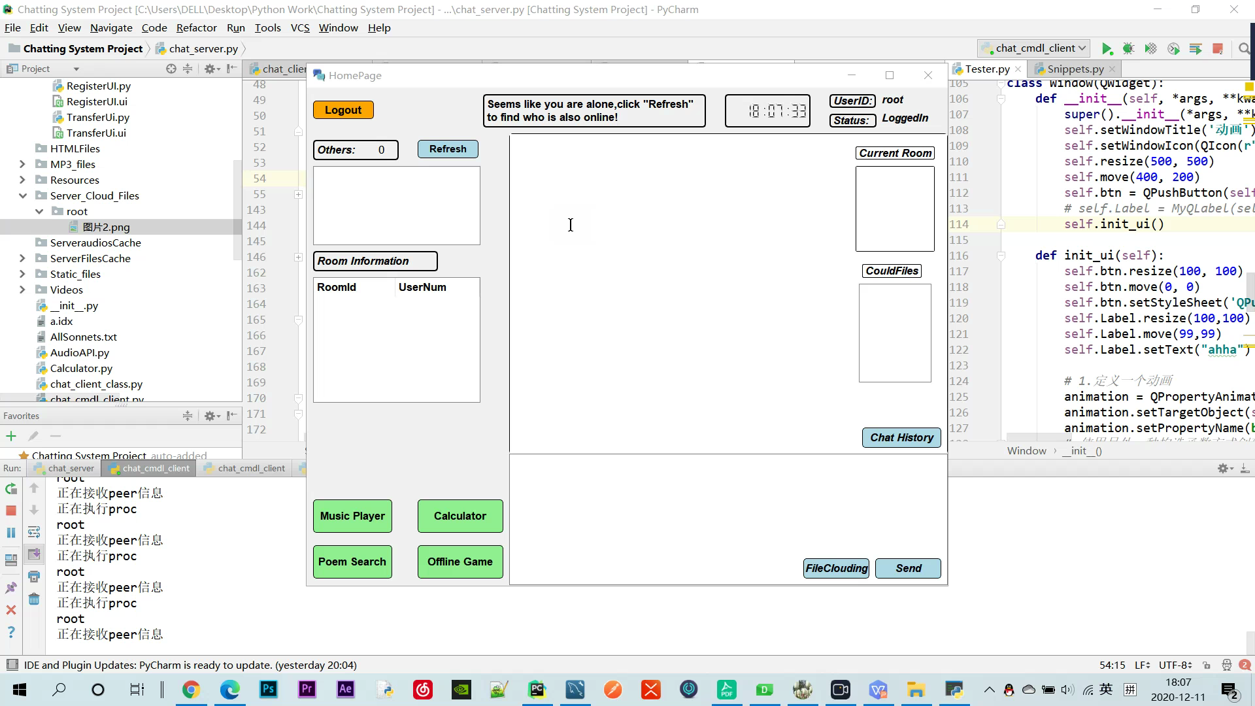
Local Music Player

Slide 15
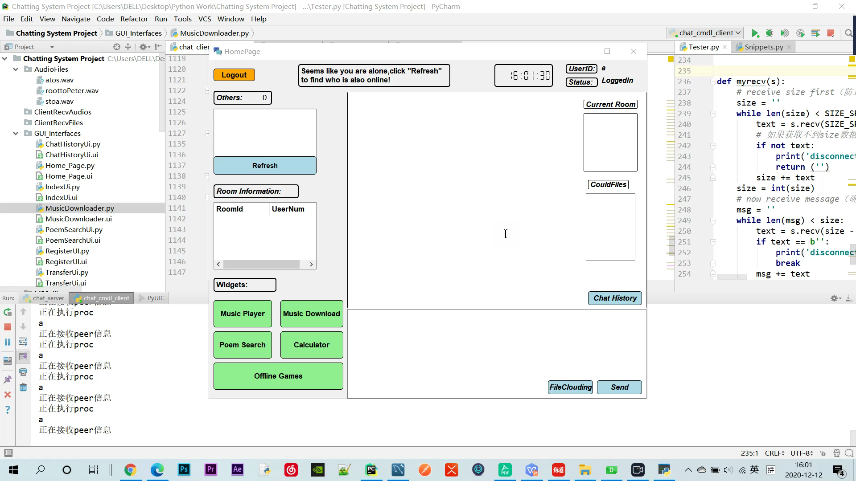
Music Download

Slide 16

Calculator

Slide 17
Poem Search
And
Chat History

Slide 18
Offline Games(Just for a taste of Pygame Module)

Slide 19
Techniques and Source Code
04

Slide 20
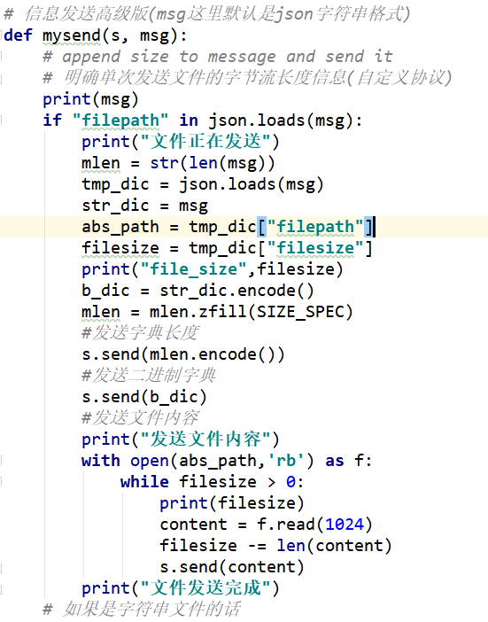
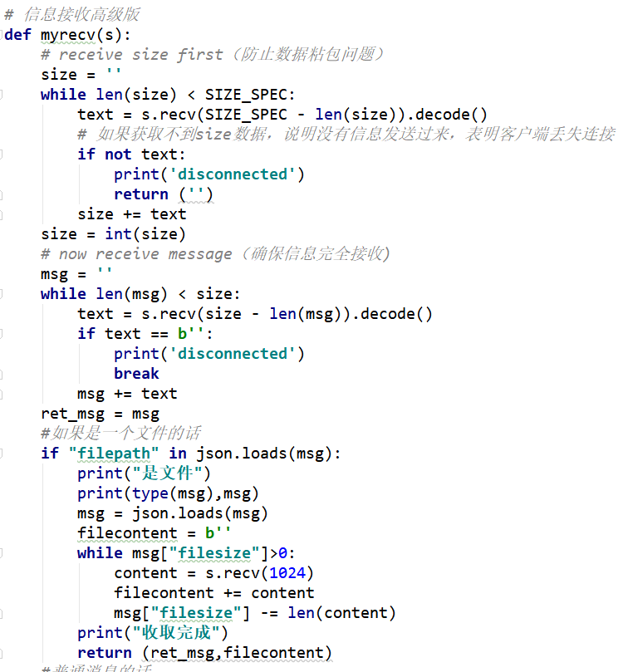
FileTransferring

Slide 21
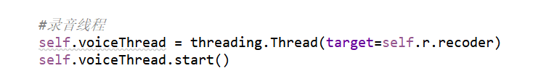
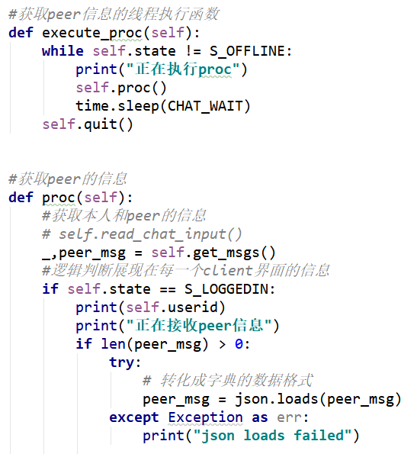
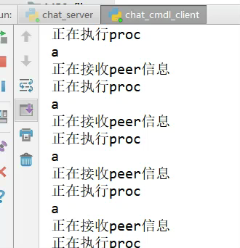
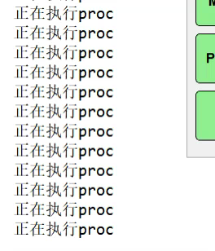
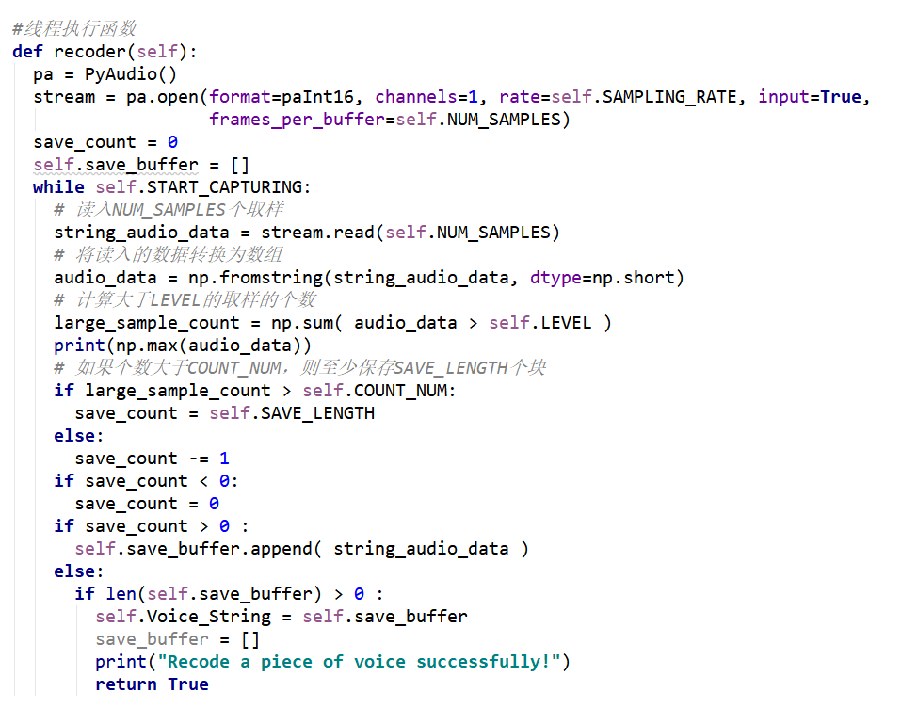
Threading

Slide 22
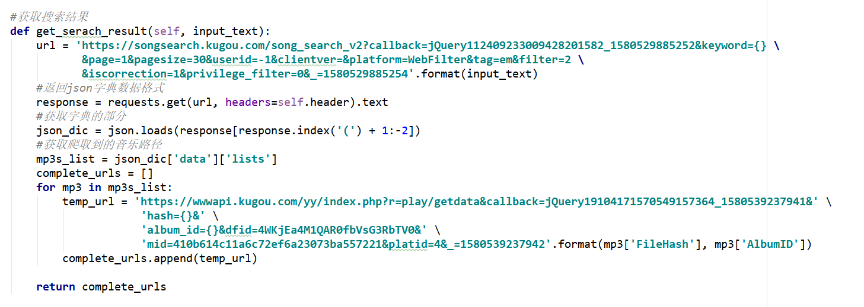
Web Crawling

Slide 23
More to realize

Slide 24

Few things to explore
Use opencv to realize realtime voice chatting and video chatting.
Iconize all the buttons.
Integrate animation into the GUI.
Distribute the chatting system to linux server.
Local game:Better AI, better map design, more visual and audio interaction.

Slide 25
Thank you!

Slide 26
Q&A

